Slide 1
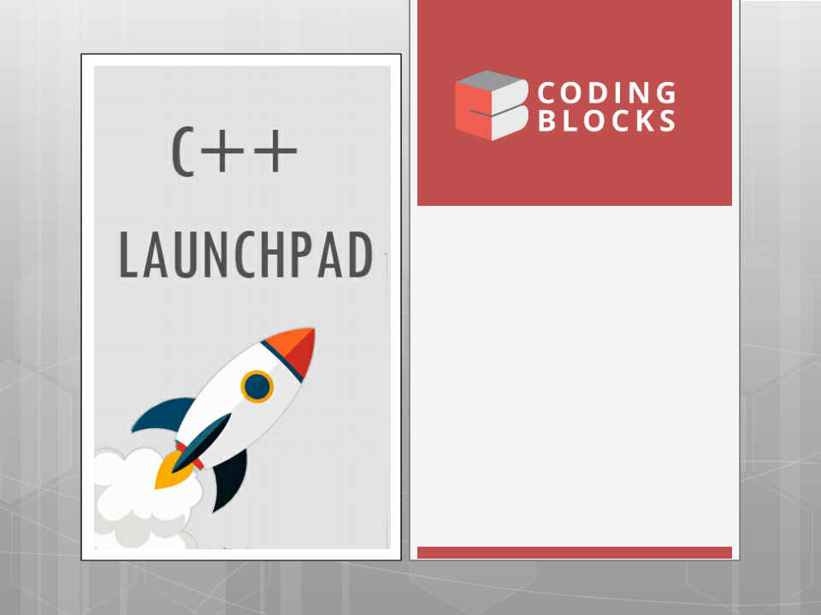
Lecture-5
Fundamentals-IV
•
Arrays
Functions
•
Kartik Mathur

Slide 2

Optimsing Bubble Sort !

Slide 3
Other Language Constructs
do while
switch case
Tertiary operator ( ? : )

Slide 4
Time to talk about functions?

Slide 5
What is a function?
A function groups a number of program
instructions into one unit and gives it a name.
This can then be invoked from other parts of
the program.
It adds conceptual organization, increases
reusability and readability of the code.

Slide 6
Lets move some programs to functions!
Write function to print a table of Fahrenheit
to Celsius table from 0 to 300 and step 20.
Lets convert the above to take limits from
the user.
Write a function to check if a number is
prime or not.
Use above in another function to generate
all prime numbers from 2 to N, where N is
given by user.

Slide 7
So a function looks like :
type name ( parameter1, parameter2, …) {
statements
}
type is the type of the value returned by the function.
name is the identifier by which the function can be called.
parameters (as many as needed): Each parameter consists of
a type followed by an identifier, with each parameter being
separated from the next by a comma. Each parameter looks
very much like a regular variable declaration (for example: int
x), and in fact acts within the function as a regular variable
which is local to the function. The purpose of parameters is to
allow passing arguments to the function from the location
where it is called from.
statements is the function's body. It is a block of statements
surrounded by braces { } that specify what the function
actually does.

Slide 8
Time to try?
Write a function to return factorial of a
number?
Write a function which uses above to
calculate NCR

Slide 9
Call Stack?

Slide 10
Scope of Variables?

Slide 11
Call by value!

Slide 12
Call By Reference !
12

Slide 13
More about functions
A function generally has three parts
Declaration
Definition
Invoking
Declaration is optional if function is defined
above main()
A function needs to be defined or declared
before it can be called i.e. if you are calling
a function A() in function B() then A should
be declared or defined above B.

Slide 14
Passing Arrays into a function!

Slide 15
Lets do some more problems?
Write a function which takes an array and its
length as argument and returns sum of its
elements.
Write a function which takes an array as
argument and sorts them using selection
Sort.
There are two sorted arrays. First one is of size
m+n containing only m elements. Another
one is of size n and contains n elements.
Write a function to merge these two arrays
into the first array of size m+n.

Slide 16
Insertion Sort !

Slide 17
Binary Search!

Slide 18
Time to try?
Binary Search
Write a function which takes a number X and
an array and prints all prints all pairs which
sum to X.
Write a function which takes two sorted
arrays, and their lengths as arguments and
returns combined median of them without
using the third array.
Implement Insertion Sort.

Slide 19
What is next class about?
Arrays contd…

Slide 20
Thank You!
Kartik Mathur
Kartik.mathur@codingblocks.com
+91-9560196180

